Slide 1
Unit:2

Slide 2
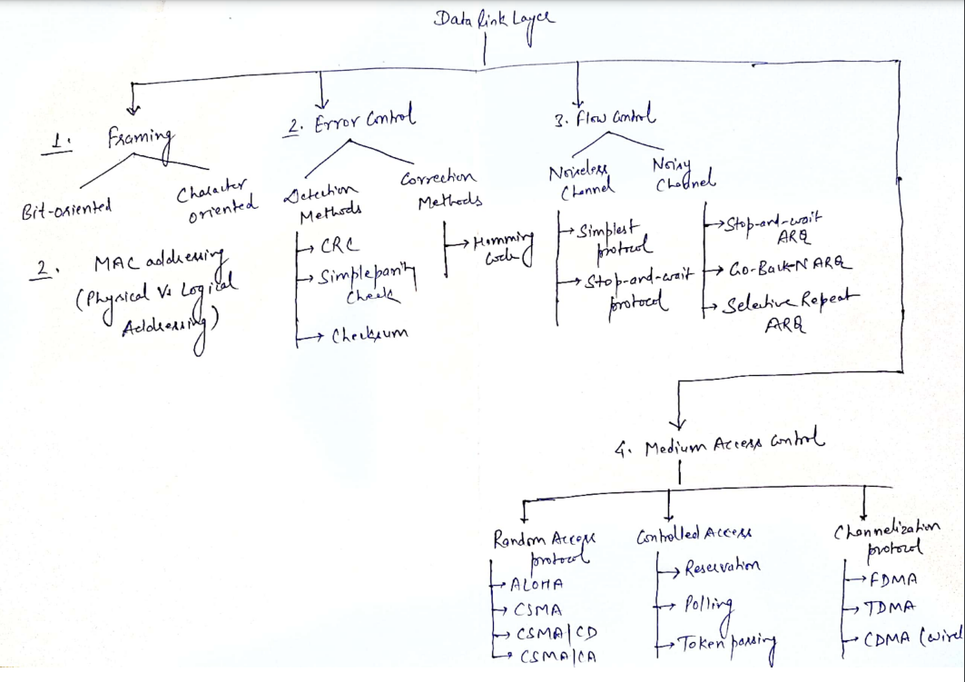

Slide 3
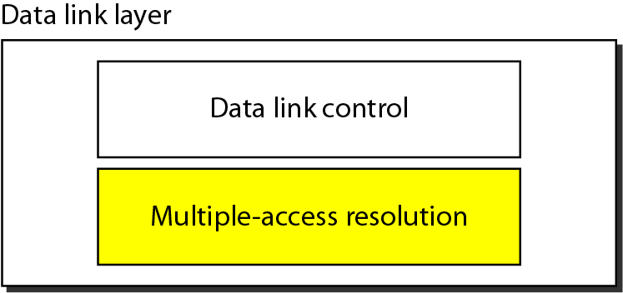
Data Link Layer
Responsible for error and flow control
Link Layer Control (LLC)
control
MAC
Responsible for framing, MAC address and Multiple Access Control
Two functionality-oriented sublayers in DATA LINK LAYER

Slide 4
THE MEDIUM ACCESS CONTROL SUBLAYER
In the OSI protocol stack, channel allocation is addressed in the Medium access control (MAC) sublayer. This is a sublayer of the Data Link Layer - considered to be below the Logical Link Control (LLC) sub-layer.
MAC layer provides an unreliable connectionless service; if required, the LLC layer can convert this into a reliable service by using an ARQ (Automatic repeat request) protocol.
The protocols used to determine who goes next on a multiaccess channel belong to a sublayer of the data link layer called the MAC (Medium Access Control) sublayer.

Slide 5
THE CHANNEL ALLOCATION PROBLEM:
Links are classified as either broadcast or point-to-point. With a broadcast link, more than two users share the same transmission media. A broadcast link is also called a multiaccess channel. In such a channel, 1. A transmitter can be heard by multiple receivers 2. A receiver can hear multiple transmitters.
In any broadcast network, the key issue is how to determine who gets to use the channel when there is competition for it. To make this point, consider a conference call in which six people, on six different telephones, are all connected so that each one can hear and talk to all the others. It is very likely that when one of them stops speaking, two or more will start talking at once, leading to chaos.
In a face-to-face meeting, chaos is avoided by external means. For example, at a meeting, people raise their hands to request permission to speak. When only a single channel is available, it is much harder to determine who should go next.

Slide 6
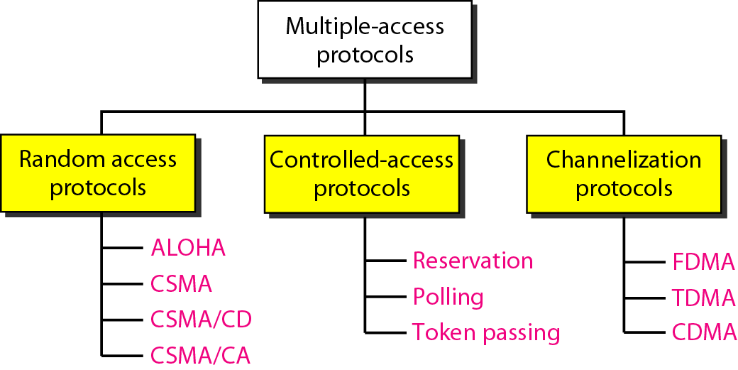
DYNAMIC APPROACH
DYNAMIC APPROACH
STATIC APPROACH

Slide 7
CHANNEL ALLOCATION APPROACHES:
How to allocate a multiaccess channel among competing users. In other words, we need a set of rules (i.e. a protocol) to allow each user to communicate and avoid interference. There are a variety of solutions to this problem that are used in practice. These solutions can be classified as either static or dynamic.
With a static approach, the channel's capacity is essentially divided into fixed portions; each user is then allocated a portion for all time. If the user has no traffic to use in its portion, then it goes unused.
With a dynamic approach, the allocation of the channel changes based on the traffic generated by the users. Generally, a static allocation performs better when the traffic is predictable. A dynamic channel allocation tries to get better utilization and lower delay on a channel when the traffic is unpredictable.

Slide 8
STATIC CHANNEL ALLOCATION TECHNIQUES :
Time Division Multiple Access (TDMA) – With TDMA the time axis is divided into time slots of a fixed length. Each user is allocated a fixed set of time slots at which it can transmit. TDMA requires that users be synchronized to a common clock. Typically extra overhead bits are required for synchronization.
Frequency Division Multiple Access (FDMA) – With FDMA the available frequency bandwidth is divided into disjoint frequency bands. A fixed band is allocated to each user. FDMA requires a guard band between user frequency bands to avoid cross-talk.
Another static allocation technique is Code Division Multiple Access (CDMA), this technique is used in many wireless networks

Slide 9
RANDOM ACCESS PROTOCOLS
In random access or contention methods, no station is superior to another station and none is assigned the control over another. No station permits, or does not permit, another station to send. At each instance, a station that has data to send uses a procedure defined by the protocol to make a decision on whether or not to send.
ALOHA ( PURE AND SLOTTED ALOHA )
Carrier Sense Multiple Access (CSMA)
Carrier Sense Multiple Access with Collision Detection (CSMA/CD)
Carrier Sense Multiple Access with Collision Avoidance (CSMA/CA)

Slide 10
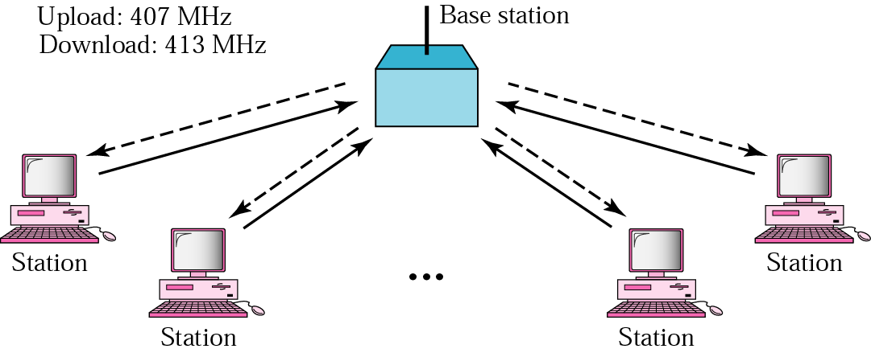
ALOHA Protocol
ALOHA is developed in the 1970s at the University of Hawaii for wireless LAN and can be used for any shared medium.
It has two variants:
PURE ALOHA
SLOTTED ALOHA
The basic idea is simple:
Let users transmit whenever they have data to be sent.
If two or more users send their frames at the same time, a collision occurs and the frames are destroyed.

Slide 11
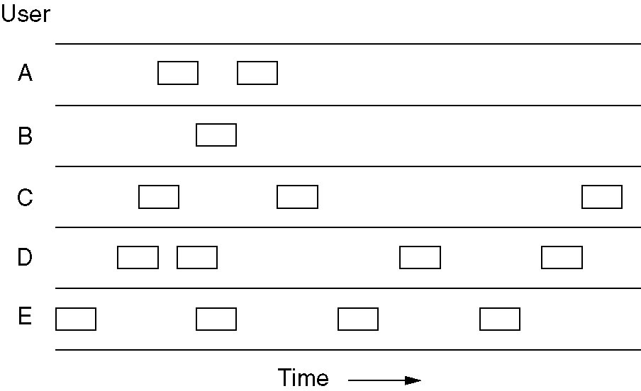
Pure ALOHA
In pure ALOHA, frames are transmitted at completely arbitrary times.
The throughput of ALOHA systems is maximized by having a uniform frame size rather than by allowing variable length frames.

Slide 12
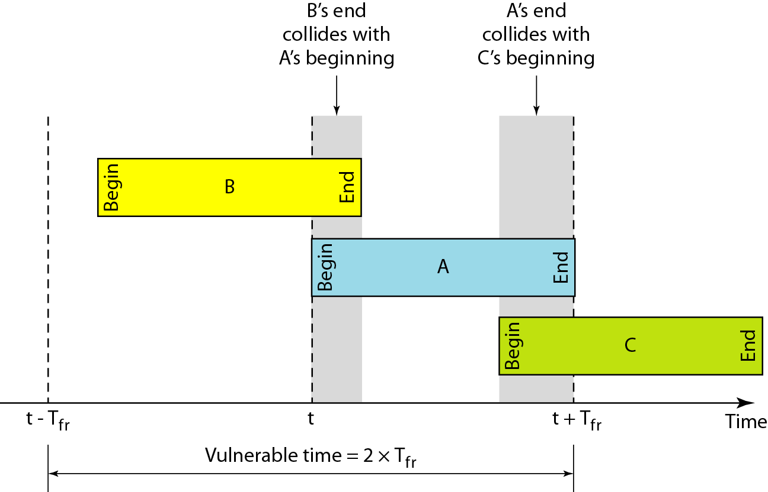
Critical ( Vulnerable ) time for pure ALOHA protocol
Under what conditions will the packet arrive A undamaged?
T_{fr}= Frame Transmission time
If the frame transmission time is T_{fr} sec
then the vulnerable time is = 2 T_{fr} sec
This means no station should send during the T-sec before this station starts transmission and no station should start sending during the T-sec period that the current station is sending.

Slide 13
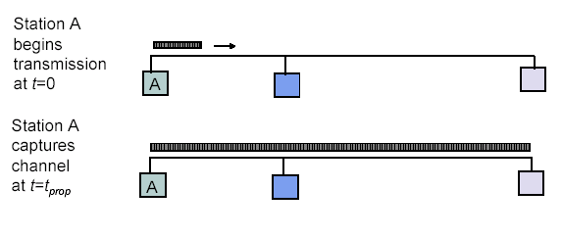
Maximum propagation delay (t_{p}):
The time it takes for a bit of a frame to travel between the two most widely separated stations.
The farthest station
Station B receives the first bit of the frame at time t= t_{p}

Slide 14
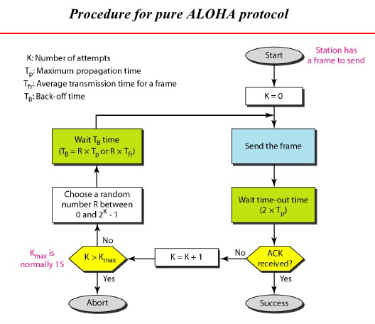

Slide 15
Throughput of Pure ALOHA
Efficiency or Throughput (S) of ALOHA defines average number of frames successfully transmitted per unit time.
The probability that n packets arrive in two packets time is given by
here –
G is average number of frames generated by the system (all stations) during one frame transmission time
(2G)
e
(
)
n
-
2
G
P
n
=
n
!
The probability P(0) that a packet is successfully received without collision is calculated by letting n=0 in the above equation. We get
We can calculate throughput S with a traffic load G as follows:

Slide 16
The throughput (S) for pure ALOHA is S = G × e ^{−2G}
The maximum throughput can be obtained by -
G = Average number of frames generated by the system (all stations) during one frame transmission time

Slide 17
Slotted ALOHA
Time is divided into slots equal to a frame transmission time (T_{fr})
A station can transmit at the beginning of a slot only
If a station misses the beginning of a slot, it has to wait until the beginning of the next time slot.
A central clock or station informs all stations about the start of a each slot

Slide 18
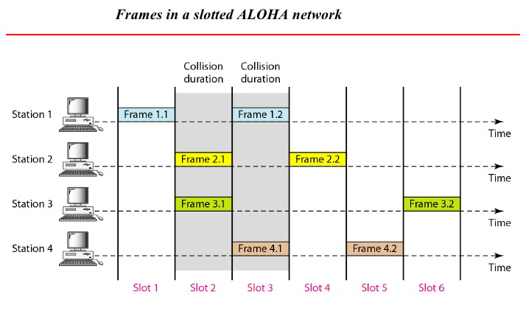

Slide 19
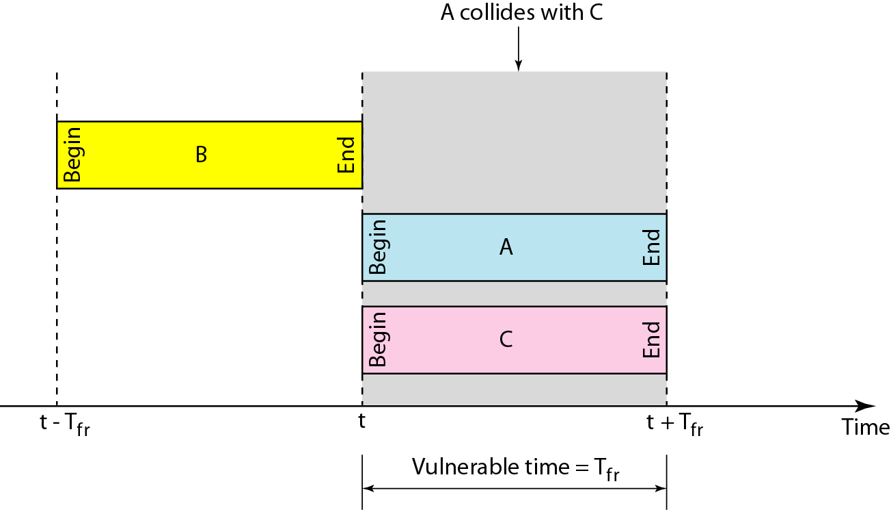
Vulnerable time for slotted ALOHA protocol

Slide 20
Slotted ALOHA
The vulnerable period is now reduced in half.
Probability of no other packet generated during the vulnerable period is:
Hence, S = G e^{-G}
Now here S_{max} = 1/e = 0.368 at G = 1
So, Maximum channel utilization is 36.8%

Slide 21
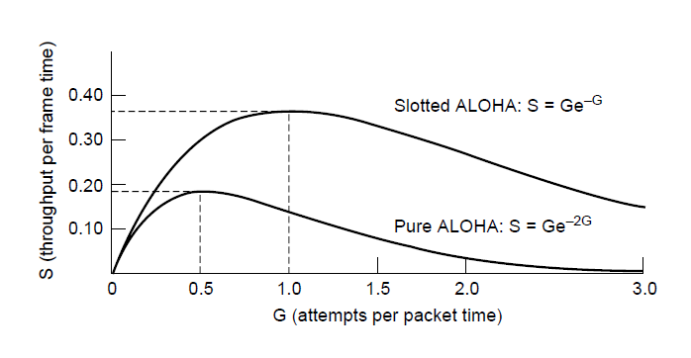
Performance Comparison of ALOHA
Slotted ALOHA can double the throughput of pure ALOHA
Slotted ALOHA peaks at G = 1, with S = 1/e ≈ 0.368, twice that of pure ALOHA. The main reason for poor channel utilization of ALOHA (pure or slotted) is that all stations can transmit at will, without paying attention to what the other stations are doing.
Throughput versus offered traffic for ALOHA systems

